Slide 1

PIC ME UP
"You might not know what you are in the mood for, but your
selfie does."

Slide 2
Problem to solve
Peoples selfies are being underutilized and are the new social currency of the 21st century.
Most people these days take selfies of themselves and don’t do anything with their pictures except share them with friends via facebook, Instagram, and other social media networks.
We believe you can do more with your selfies, than just share on social media.

Slide 3
Continued…
When you are in a certain type of mood you want to do something to get you out of your current “funk” or if you are happy to do something to keep you going and enjoy the rest of the day.
There are some Apps available today that will try and help you with this by suggesting certain songs with what you tell them but they are from a pre-made list.

Slide 4
Our solution
Our App will provide the user with more accurate options based off of the image they provide.
When the image is provided, it will suggest music based on your current mood and it will suggest some movies to watch as well.
There are Apps out there that provide music or movies with the pre-selected options they chose for you, with the mood you tell them you are in, but not both, movies and music.

Slide 5
Continued…
We will determine this based off of your image that was provided and suggest options based on you and not a list to just pick from.
We want to make this the best user experience possible and help them get out of their “funk” and provide the best options for them and suggest multiple options for them to pick from.

Slide 6
Api’s used in app
For the best user experience, we decided to use multiple API’s.
We decided to use Microsoft Face API, for the images to get feedback on mood, age and gender.
Then used the Spotify Api to help suggest what songs to play based off of the image results.
And lastly, we used The Movie Data Base (TMDB), to suggest what movies to watch based off of the image results as well.

Slide 7

Steps taken-IMAGE
We first wanted to use something that everyone does and that is using their image (selfie) and do something with it.
We used the Microsoft Face Api to help build our App since this was better for what we were using.
It was better, because it was more accurate with the emotion, gender and age of the person in the selfie, which we needed for later in the App, to help suggest music and movies.

Slide 8
Coding for the image

Slide 9
Continued…

Slide 10

Adding spotify
Spotify was the hardest part of this App due to having Authentication to use and this was a long process to grasp.
We wanted the user to get the best songs based off of the results we received from the image provided by Microsoft Face App.
For example: if the image told us that the user was happy, it would suggest songs that were happy/upbeat and if sad, it would suggest slower songs and so on.

Slide 11
Coding for spotify

Slide 12
Continued…

Slide 13

Adding tmdb
If the user wanted more than just music, we give them the option to look for a movie to watch as well.
This was easier than Spotify, since we aren’t streaming movies, we are just suggesting what movies to watch based off of their image provided.

Slide 14
coding for tmdb
We have the TMDB Api

Slide 15
Continued…

Slide 16

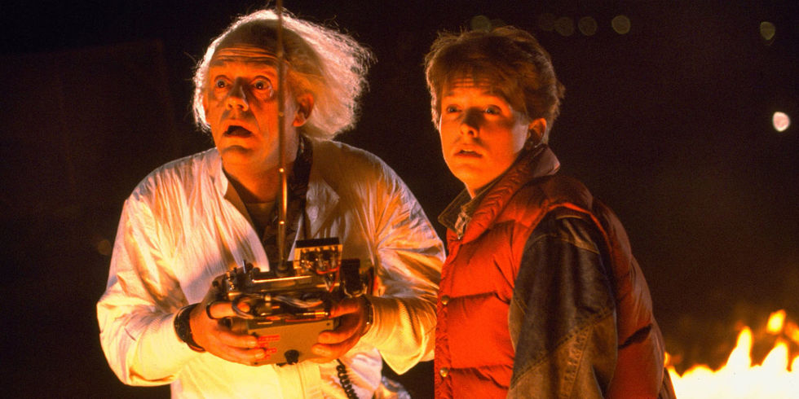
UPDATES FOR THE FUTURE!!!

Slide 17

Updates for the future
Some things we would like to add/update on our App are:
Make our App available for all ages…we are just concentrating on 18+ for now.
Have an API for Ratings on movies so we can we can make the App child user friendly.
Make our App capable of playing the suggested movie based off of the users mood.

